Slide 1
Motor control
Slide
of 59
Position estimation
Analog signal acquisition
Closed loop algorithm
Nicolai

Slide 2
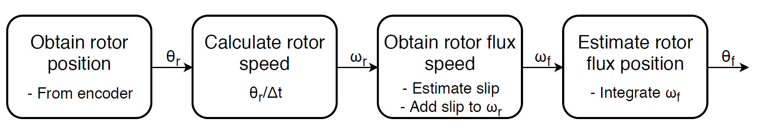
Position estimation
Slide
of 59
Nicolai
Notes:
Calculate position from amount of pulses received
Calculate speed from the position change every 30 electrical degrees or within a specified time period (If speed is slow)
Slip speed is estimated from Machine parameters and dq-current references
Rotor flux speed is found by adding the shaft speed and the slip speed.
Integrated to optain estimated flux position, used for reference frame transformations

Slide 3
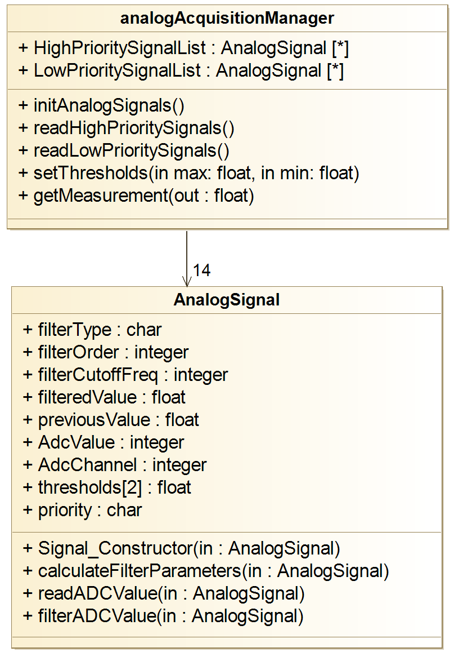
Analog signal acquisition
Slide
of 59
Analog signal structure
Raw ADC value
Filtered value
Previous value
Filter order
Filter frequency
Filter parameters
ADC channel
Priority
Safety thresholds
Nicolai

Slide 4
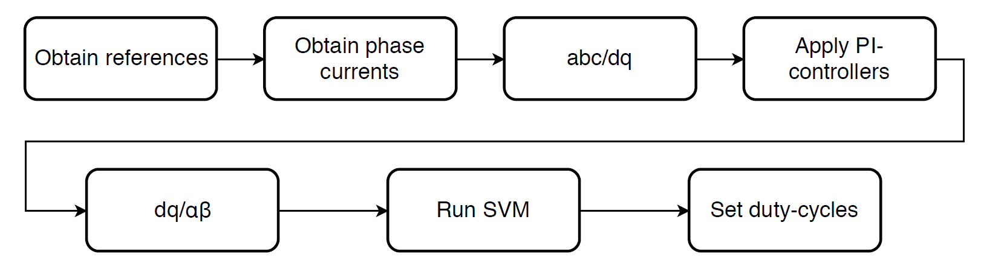
Closed loop control algorithm
Slide
of 59
Nicolai

Slide 5
Safety
Slide
of 59
Monitors possible error sources
Overvoltage
Overcurrent
Inverter and battery temperatures
Performs the necessary safety reaction
Includes a watchdog timer
Nicolai

Slide 6
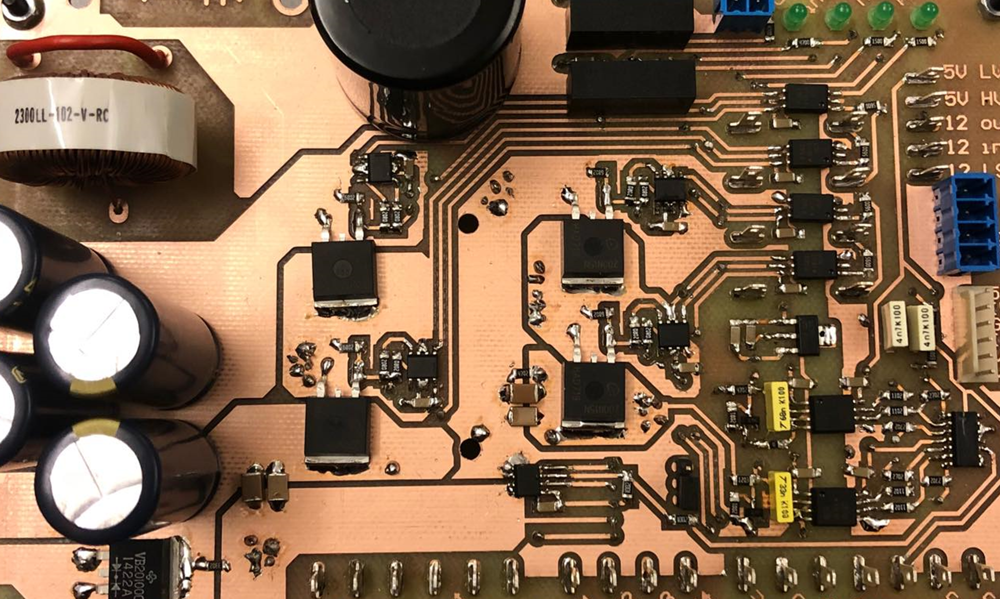
System tests

Slide 7
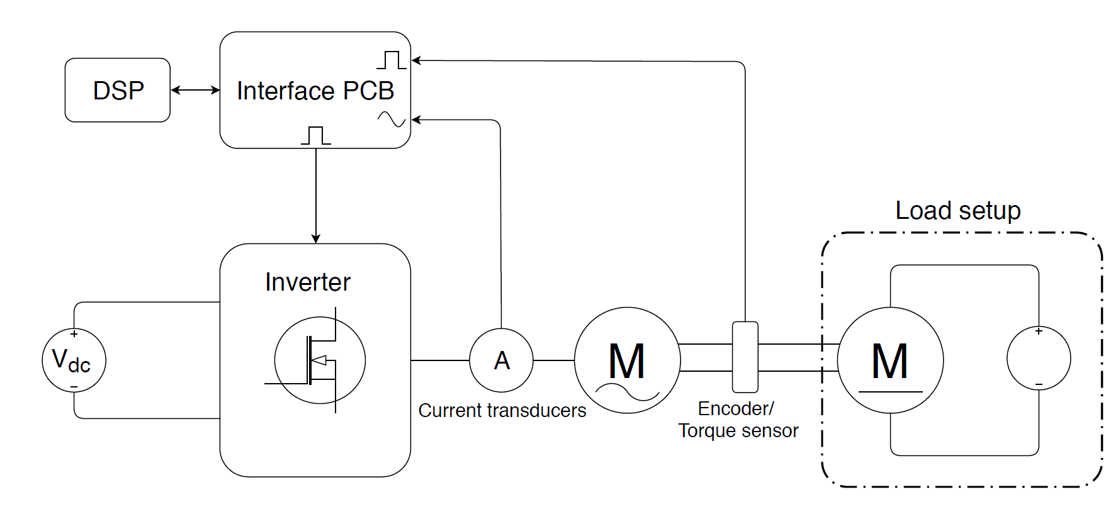
Test setup
Slide
of 59
Nicolai

